Slide 1
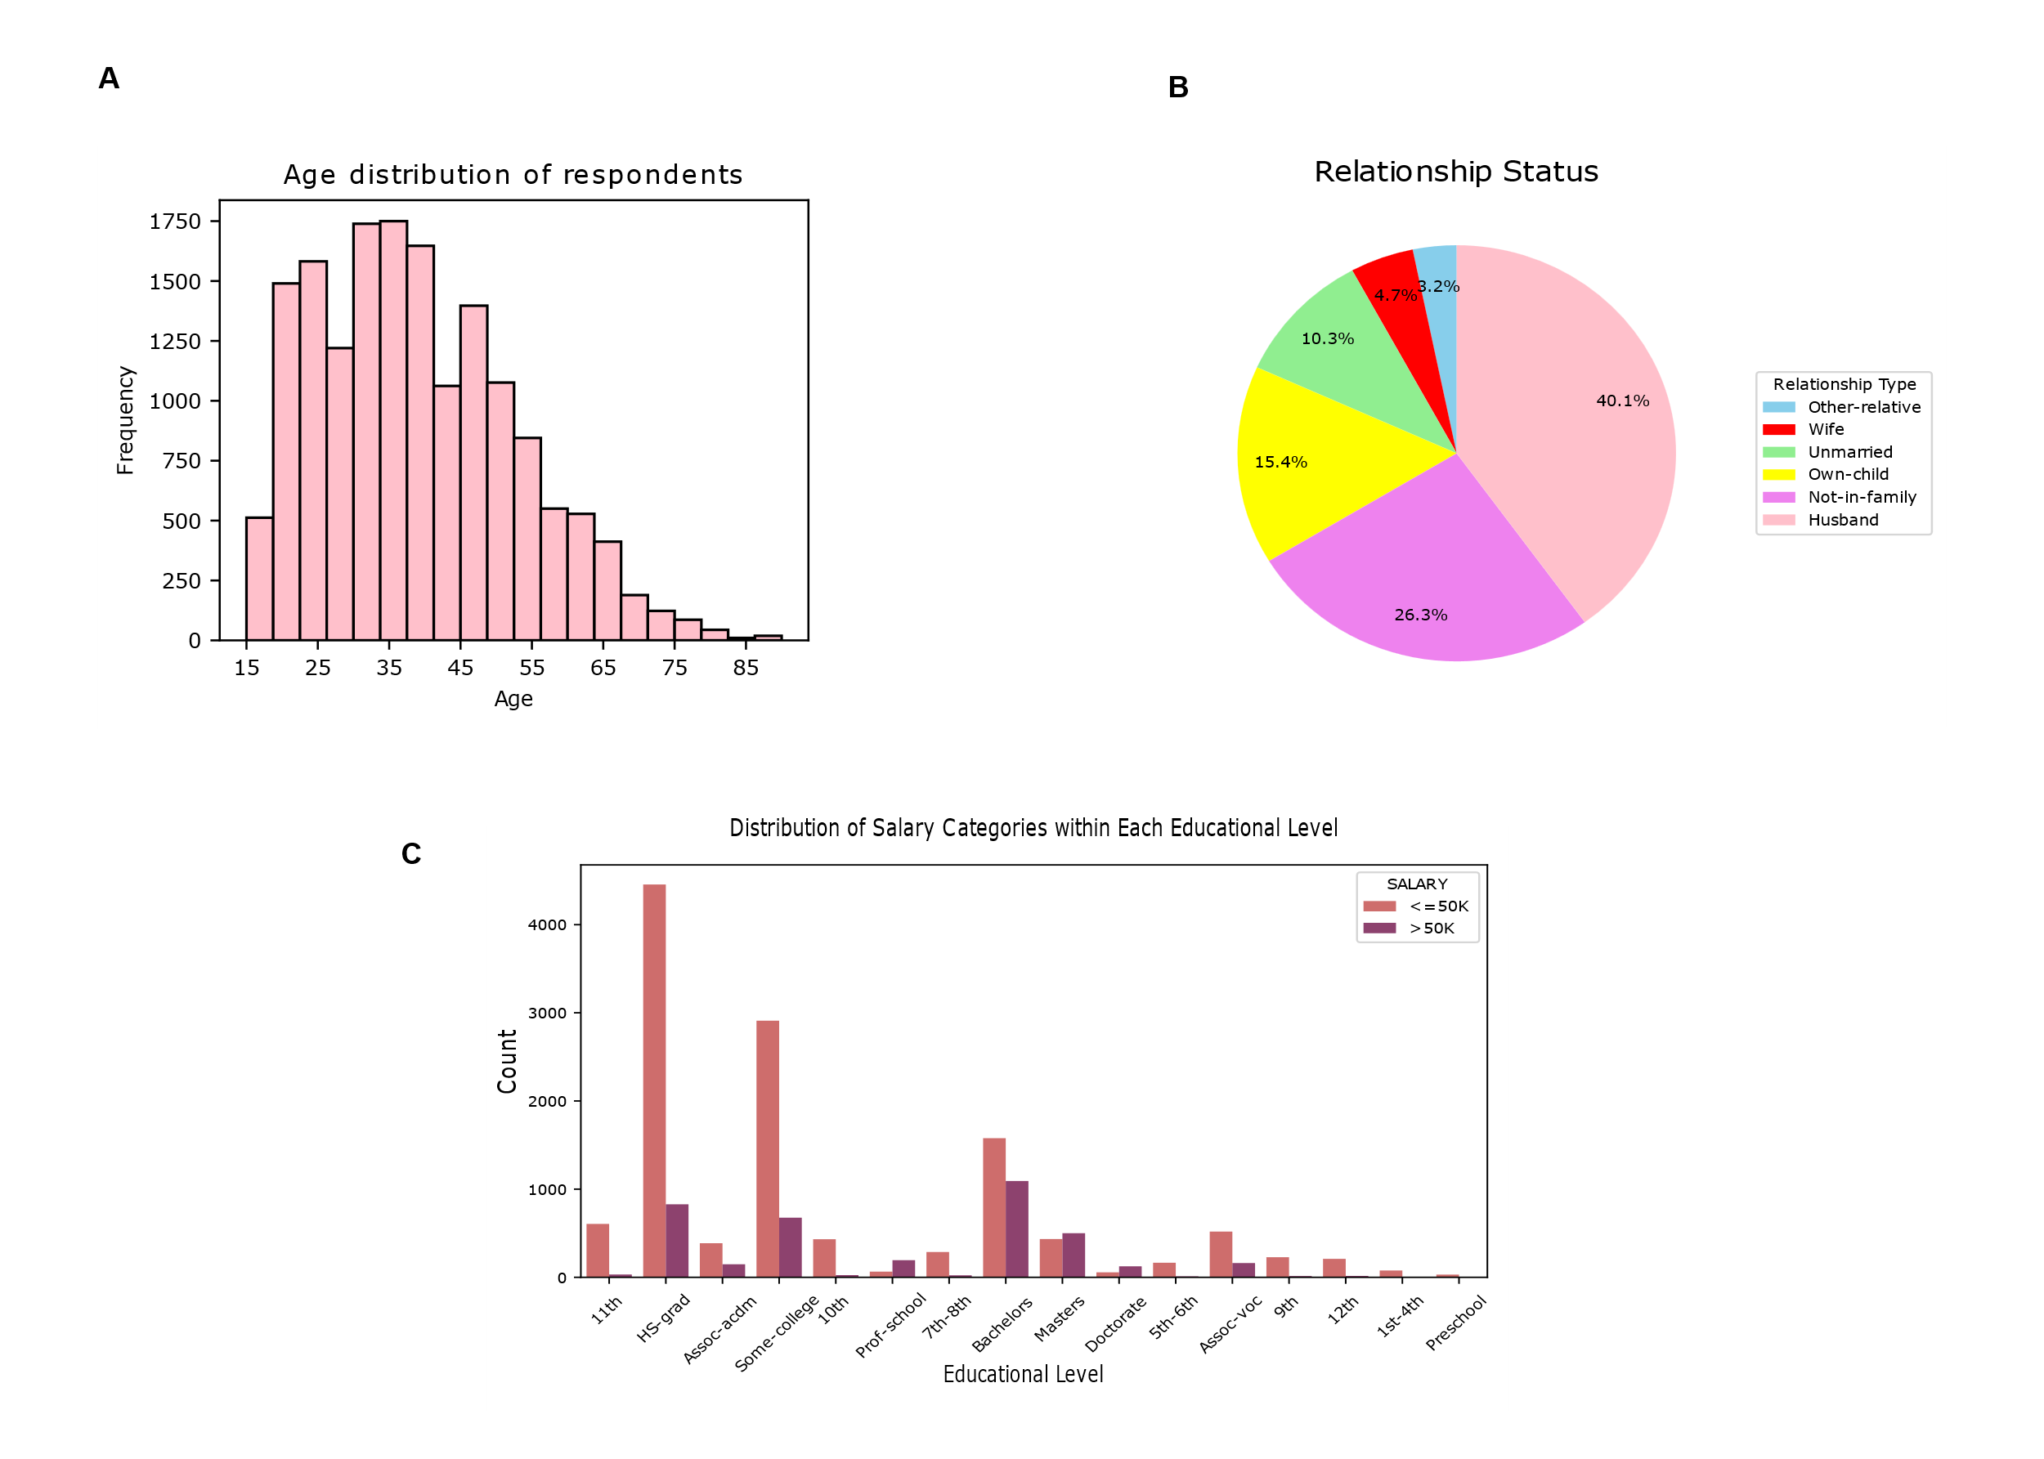
Figure A: The histogram is an accurate way to visualize the data as the age of the respondents can be grouped together and viewed in an easier manner. Histograms are best suited where intervals of data are predominant or can be generated.
Figure B: The pie chart accurately depicts the occurrence of a particular type of relationship status as all the respondents will definitely fall under one of the categories and hence, the total has to match the sum of respondents(100 percent) which is the whole in a pie chart.
Figure C: The salary is divided among those <=50K and those >50K. Since we want to show the number of people in each education level with the two type of salaries, a grouped bar plot is the best representation. We can distinctly discern characteristics of the data and visualize the trends here for each education level.
Alap Mundayoor, M.N. 23351429, IdM: ow07ysym

